Slide 1
Air Toxics in US Communities
An investigation of toxic air pollution and related respiratory hazard and cancer risks in low and high percent minority communities in the U.S.
Presented By: Kate Wessels

Slide 2
Overview and Data

Slide 3
Overview and Data
EPA’s 2019 EJSCREEN dataset
Environmental and demographic indicators by census tract and block group

Slide 4
Overview and Data
EPA’s 2019 EJSCREEN dataset
Environmental and demographic indicators by census tract and block group
In this analysis:
Percent Minority - the % of people in a census tract block group who listed on their census their racial status as a race other than White alone and/or listed listed their ethnicity as Hispanic or Latino
PM 2.5 (ug/m3): particulate matter under 1 micron per cubic meter
Ozone (ppb): ozone concentration in the air in parts per billion
Respiratory hazard index: respiratory hazard risk, measured as a ratio of exposure concentration to health-based reference concentration
Cancer (lifetime risk per million): lifetime cancer risk from inhalation of air toxics (per million people)

Slide 5
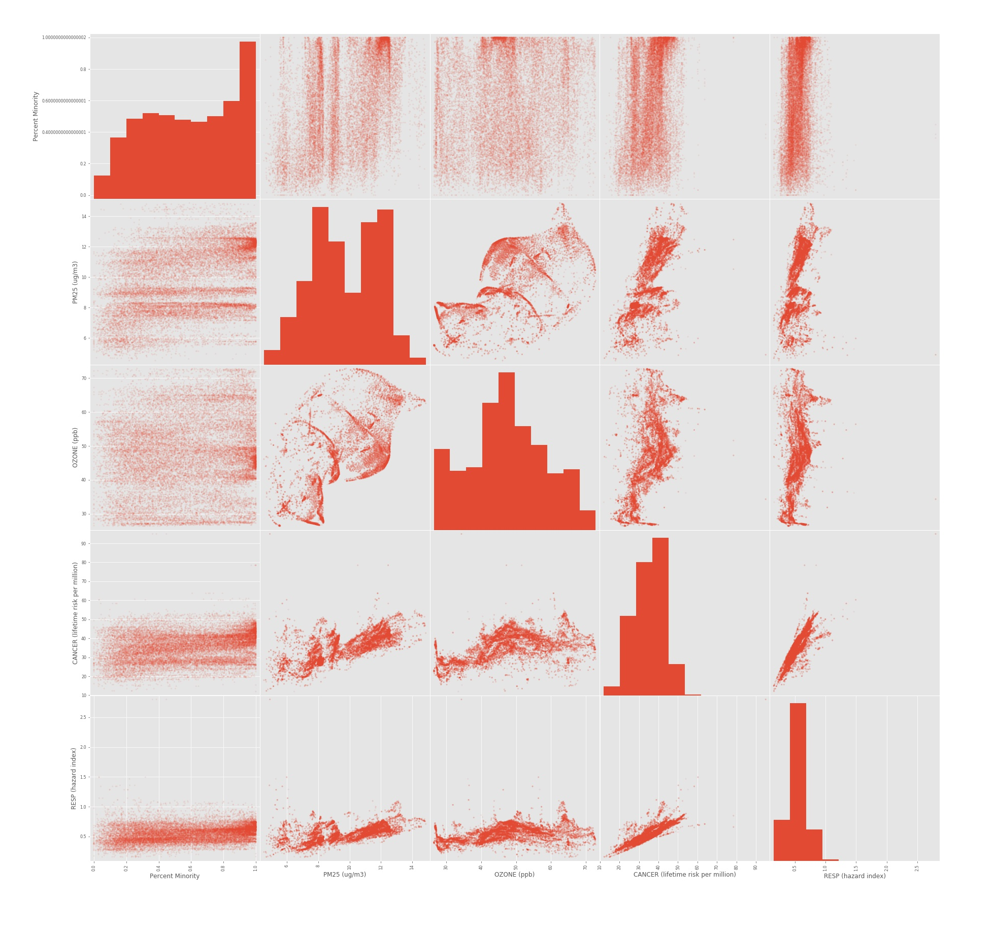
Data Analysis
Scatter matrix for each of the different indicators:
Percent Minority
PM 2.5 (ug/m3)
Ozone (ppb)
Cancer (lifetime risk per million)
Respiratory hazard index

Slide 6
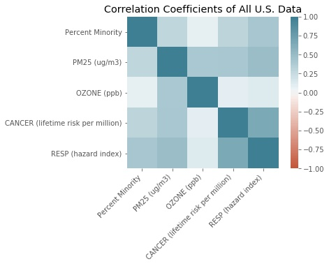

Slide 8
Exploration #1: Is there a difference in the average respiratory hazard index in low minority and high minority block groups?

Slide 9
Exploration #1: Is there a difference in the average respiratory hazard index in low minority and high minority block groups?
Two groups:
“Low minority” block groups:
percent minority < 50%
~150,000 block groups
“High minority” block groups:
Percent minority >= 50%
~66,000 block groups

Slide 10
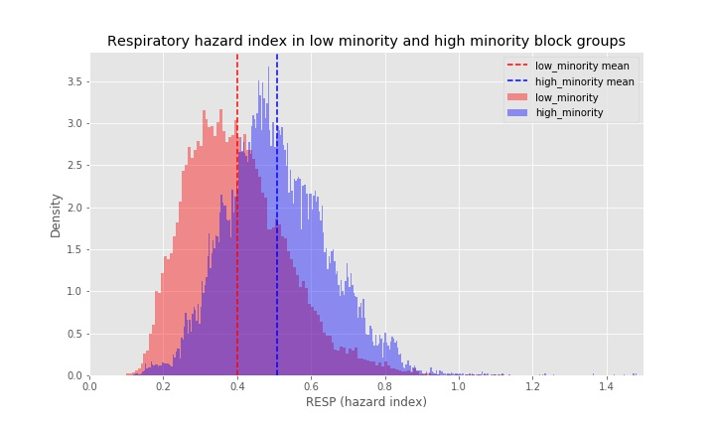
Exploration #1: Is there a difference in the average respiratory hazard index in low minority and high minority block groups?
Two groups:
“Low minority” block groups:
percent minority < 50%
~150,000 block groups
“High minority” block groups:
Percent minority >= 50%
~66,000 block groups

Slide 11
Exploration #1: Is there a difference in the average respiratory hazard index in low minority and high minority block groups?
Hypothesis Test Setup:
Null Hypothesis: H₀
- The average respiratory hazard index in low minority groups is equal to the average respiratory hazard index in high minority block groups.
Alternate Hypothesis: H_{a}
- The average respiratory hazard index in high minority groups is greater than the average respiratory hazard index in low minority block groups.
Significance Level
- 95% confidence interval

Slide 12
Exploration #1: Is there a difference in the average respiratory hazard index in low minority and high minority block groups?
Results:
Mean:
Low minority RESP hazard index: 0.400
High minority RESP hazard index: 0.509

Slide 13
Exploration #1: Is there a difference in the average respiratory hazard index in low minority and high minority block groups?
Results:
Mean:
Low minority RESP hazard index: 0.400
High minority RESP hazard index: 0.509
Standard error:
low minority RESP hazard index: 0.000358
high minority RESP hazard index: 0.000542

Slide 14
Exploration #1: Is there a difference in the average respiratory hazard index in low minority and high minority block groups?
Results:
Mean:
Low minority RESP hazard index: 0.400
High minority RESP hazard index: 0.509
Standard error:
low minority RESP hazard index: 0.000358
high minority RESP hazard index: 0.000542
Effect size: 0.109

Slide 15
Exploration #1: Is there a difference in the average respiratory hazard index in low minority and high minority block groups?
Results:
Mean:
Low minority RESP hazard index: 0.400
High minority RESP hazard index: 0.509
Standard error:
low minority RESP hazard index: 0.000358
high minority RESP hazard index: 0.000542
Effect size: 0.109
U-test:
P-value: 0.0
Assuming a 95% confidence interval, reject the null hypothesis that there is no difference in average RESP hazard index in low and high minority block groups
Accept the alternate hypothesis that average respiratory hazard index is greater in high minority block groups

Slide 16
Exploration #2: Is there a difference in the average PM 2.5 concentrations in low minority and high minority block groups?

Slide 17
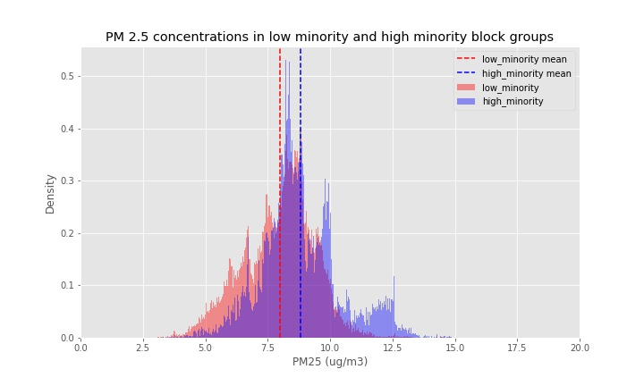
Exploration #2: Is there a difference in the average PM 2.5 concentrations in low minority and high minority block groups?

Slide 18
Exploration #2: Is there a difference in the average PM 2.5 concentrations in low minority and high minority block groups?
Results:
Mean:
Low minority RESP hazard index: 7.979
High minority RESP hazard index: 8.819

Slide 19
Exploration #2: Is there a difference in the average PM 2.5 concentrations in low minority and high minority block groups?
Results:
Mean:
Low minority RESP hazard index: 7.979
High minority RESP hazard index: 8.819
Standard error:
low minority PM 2.5 concentrations: 0.00370
high minority PM 2.5 concentrations: 0.00619

Slide 20
Exploration #2: Is there a difference in the average PM 2.5 concentrations in low minority and high minority block groups?
Results:
Mean:
Low minority RESP hazard index: 7.979
High minority RESP hazard index: 8.819
Standard error:
low minority PM 2.5 concentrations: 0.00370
high minority PM 2.5 concentrations: 0.00619
Effect size: 0.840

Slide 21
Exploration #2: Is there a difference in the average PM 2.5 concentrations in low minority and high minority block groups?
Results:
Mean:
Low minority RESP hazard index: 7.979
High minority RESP hazard index: 8.819
Standard error:
low minority PM 2.5 concentrations: 0.00370
high minority PM 2.5 concentrations: 0.00619
Effect size: 0.840
U-test:
P-value: 0.0
Assuming a 95% confidence interval, reject the null hypothesis that there is no difference in average PM 2.5 concentrations in low and high minority block groups
Accept the alternate hypothesis that average PM 2.5 concentrations is greater in high minority block groups

Slide 22
Exploration #3: Is there a difference in the average cancer risk in low minority and high minority block groups?

Slide 23
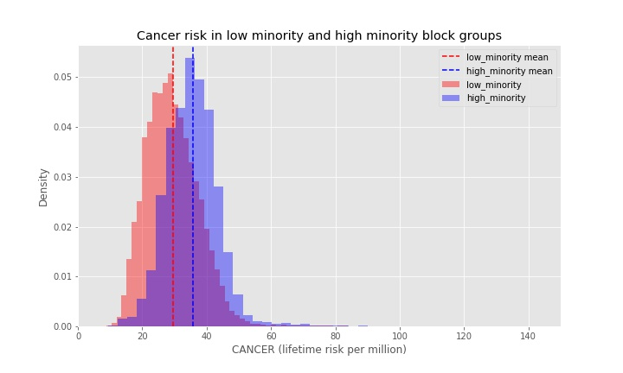
Exploration #3: Is there a difference in the average cancer risk in low minority and high minority block groups?

Slide 24
Exploration #3: Is there a difference in the average cancer risk in low minority and high minority block groups?
Results:
Mean:
Low minority RESP hazard index: 29.621
High minority RESP hazard index: 35.787

Slide 25
Exploration #3: Is there a difference in the average cancer risk in low minority and high minority block groups?
Results:
Mean:
Low minority RESP hazard index: 29.621
High minority RESP hazard index: 35.787
Standard error:
low minority cancer risk: 0.028
high minority cancer risk: 0.052

Slide 26
Exploration #3: Is there a difference in the average cancer risk in low minority and high minority block groups?
Results:
Mean:
Low minority RESP hazard index: 29.621
High minority RESP hazard index: 35.787
Standard error:
low minority cancer risk: 0.028
high minority cancer risk: 0.052
Effect size: 6.165

Slide 27
Exploration #3: Is there a difference in the average cancer risk in low minority and high minority block groups?
Results:
Mean:
Low minority RESP hazard index: 29.621
High minority RESP hazard index: 35.787
Standard error:
low minority cancer risk: 0.028
high minority cancer risk: 0.052
Effect size: 6.165
U-test:
P-value: 0.0
Assuming a 95% confidence interval, reject the null hypothesis that there is no difference in average cancer risk low and high minority block groups
Accept the alternate hypothesis that average cancer risk is greater in high minority block groups

Slide 28
Exploration #4: Is there a difference in the average ground-level Ozone concentrations in low minority and high minority block groups?

Slide 29
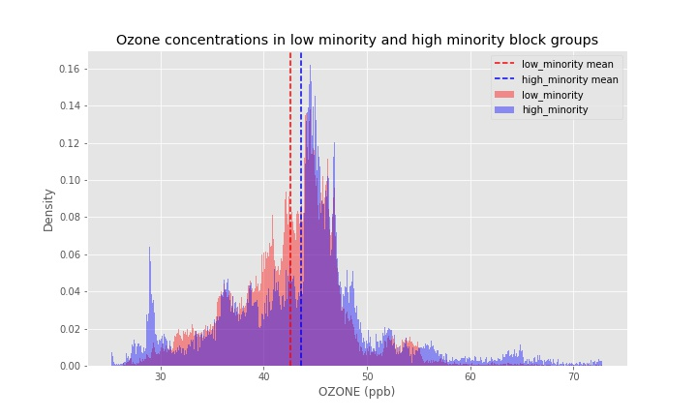
Exploration #4: Is there a difference in the average ground-level Ozone concentrations in low minority and high minority block groups?

Slide 30
Exploration #4: Is there a difference in the average ground-level Ozone concentrations in low minority and high minority block groups?
Results:
Standard error:
low minority Ozone concentration: 0.014
high minority Ozone concentration: 0.030

Slide 31
Exploration #4: Is there a difference in the average ground-level Ozone concentrations in low minority and high minority block groups?
Results:
Standard error:
low minority Ozone concentration: 0.014
high minority Ozone concentration: 0.030
Effect size: 1.007

Slide 32
Exploration #4: Is there a difference in the average ground-level Ozone concentrations in low minority and high minority block groups?
Results:
Mean:
Low minority RESP hazard index: 42.628
High minority RESP hazard index: 43.635
Standard error:
low minority Ozone concentration: 0.014
high minority Ozone concentration: 0.030
Effect size: 1.007
U-test:
P-value: 3.4 * 10⁻²⁸
Unable to reject null hypothesis here, after considering the effect size relative to the sample means and the standard error of each sample

Slide 33
Summary of Results

Slide 34
Summary of Results
With 95% confidence, we accept that:
The average respiratory hazard index is greater in high minority block groups compared to low minority block groups
The average PM 2.5 concentration is greater in high minority block groups compared to low minority block groups
The average cancer risk is greater in high minority block groups compared to low minority block groups

Slide 35
Summary of Results
With 95% confidence, we accept that:
The average respiratory hazard index is greater in high minority block groups compared to low minority block groups
The average PM 2.5 concentration is greater in high minority block groups compared to low minority block groups
The average cancer risk is greater in high minority block groups compared to low minority block groups
With 95% confidence, we are unable to reject that:
The average Ozone concentration is the same in low minority and high minority block groups

Slide 36
Why do the Results Matter?

Slide 37
Next Steps

Slide 38
Next Steps
Further analysis and hypothesis testing in Alameda county

Slide 39
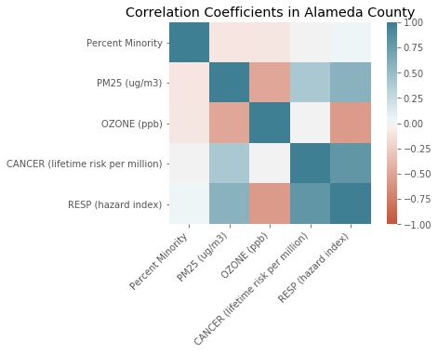
Next Steps
Further analysis and hypothesis testing in Alameda county

Slide 40
Next Steps
Further analysis and hypothesis testing in Alameda county
Further analysis and hypothesis testing across other counties in California.

Slide 41
Hypothesis Testing in Alameda county

Slide 42
Hypothesis Testing in Alameda county
Is there a difference in the average respiratory hazard index in low minority and high minority block groups within Alameda County?

Slide 43
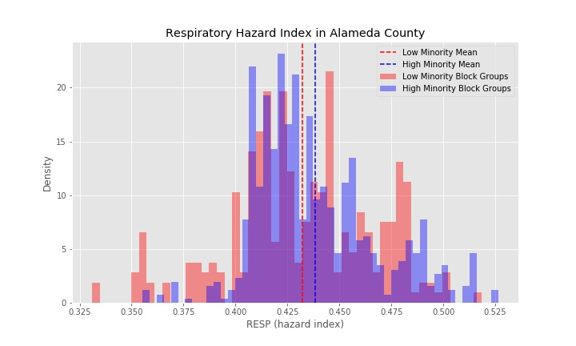
Hypothesis Testing in Alameda county
Is there a difference in the average respiratory hazard index in low minority and high minority block groups within Alameda County?

Slide 44
Hypothesis Testing in Alameda county
Is there a difference in the average respiratory hazard index in low minority and high minority block groups within Alameda County?
Results:
Mean:
Low minority RESP hazard index: 0.432
High minority RESP hazard index: 0.438
Standard error:
low minority RESP hazard index: 0.000358
high minority RESP hazard index: 0.000542
Effect size: 0.00596
U-test:
P-value: 0.074
Assuming a 95% confidence interval, unable to reject the null hypothesis that average respiratory hazard index is the same in low and high minority block groups

